Slide 1
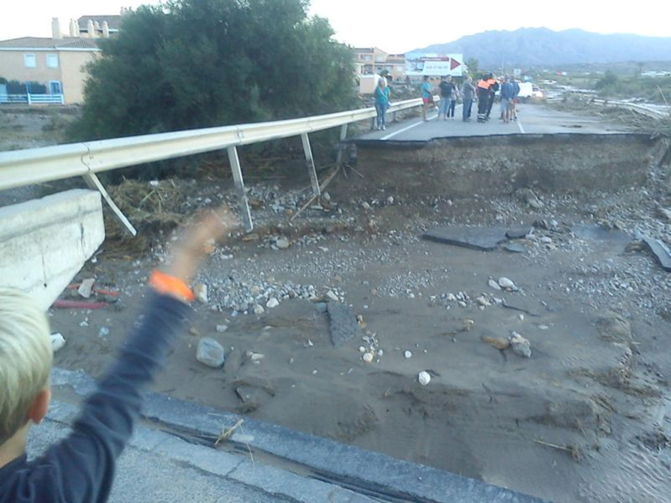
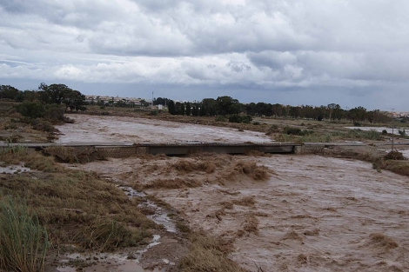
Flood monitoring for ungauged rivers - Across the globe
Beatriz Revilla Romero¹, Jutta Thielen¹, Peter Salamon¹ and Tom de Groeve^{1,} Damien Raynaud¹ and teams
Florian Pappenberger and ECMWF team²
¹European Commission Joint Research Centre
²European Centre Medium-Range Weather Forecast

Slide 2
Challenges for flood risk management at continental and global scale
(Hyogo and Post-2015 (HFA2) Framework)
  Knowledge and data sharing across borders
  Trans-boundary collaboration
  Effective use of space-based earth observation and in situ measurements
  Flood forecasting systems and early warning systems for entire river basins
Recovery
Prevention
Crisis
Response
Preparedness
Global Flood Detection
System
Global Flood Awareness System
Integrated tool

Slide 3
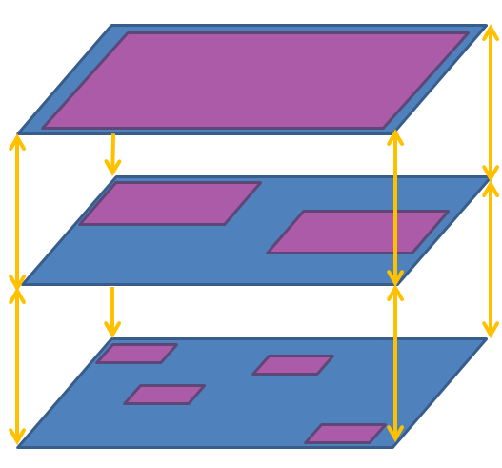
Objectives for Global Systems
Novel products for International Aid
Organisations
JRC Global Flood Forecasting and Detection System
Added value for
National/Regional flood
forecasting agencies
Research & operational organisations
Collaborations & Partnerships
Complementary information
Local authorities

Slide 4
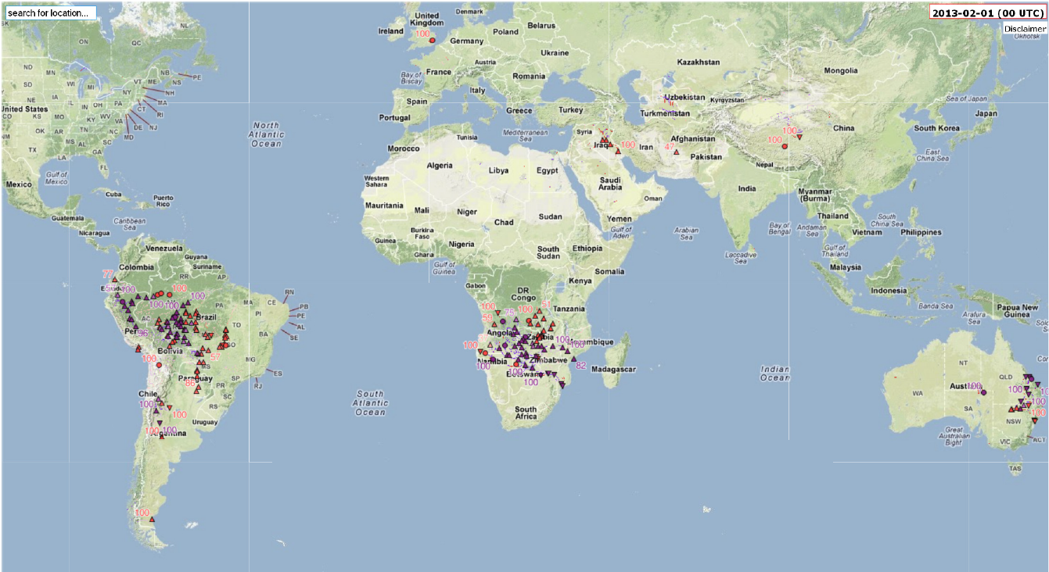
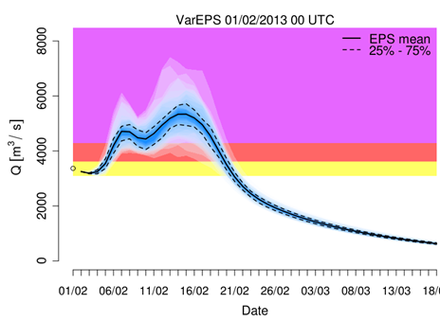
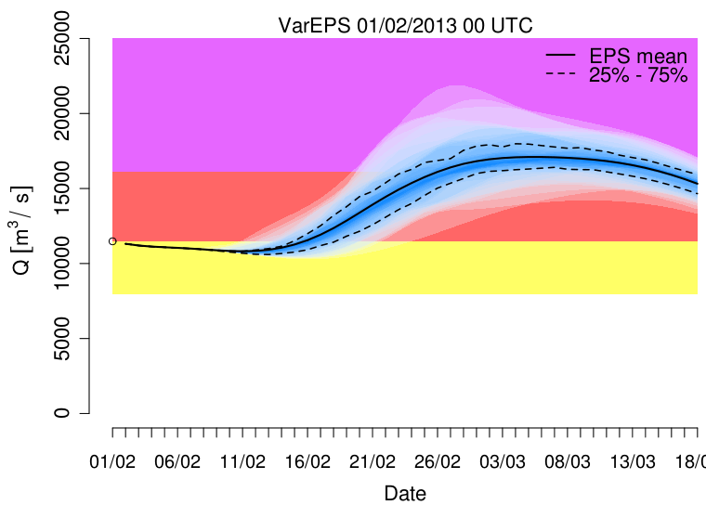
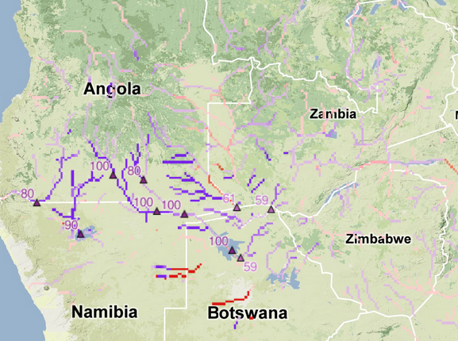
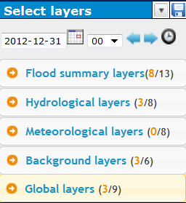
Forecasting: Global Flood Awareness System (GloFAS)
  Novel products for international aid
    Global early flood probability information up to 30 days in advance
    Worldwide comparable information
  Added value for National Services
    Catchment based information
    Probabilistic information (ensemble predictions)
  Communication
    User friendly web-interface
    High-level as well as expert information

Slide 5
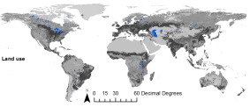
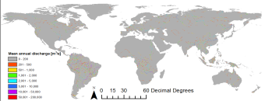
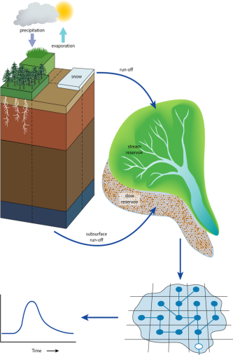
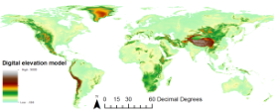
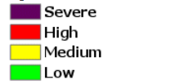
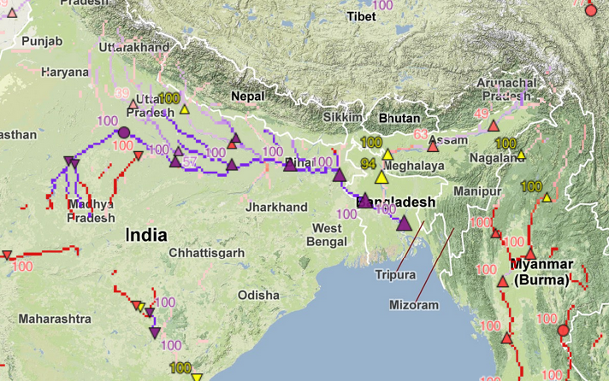
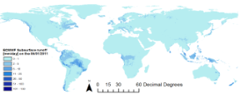
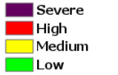
Forecasting: Global Flood Awareness System (GloFAS)
Daily Input:
- Spatial GIS data
Daily Output:
Discharge forecasts
Flood threshold exceedance
Hydro-Meteo model
- Multiple weather forecasts , (ensembles)
Spatial resolution 0.1 degree
ECMWF VAREPS for forecasts since
June 2011

Slide 6
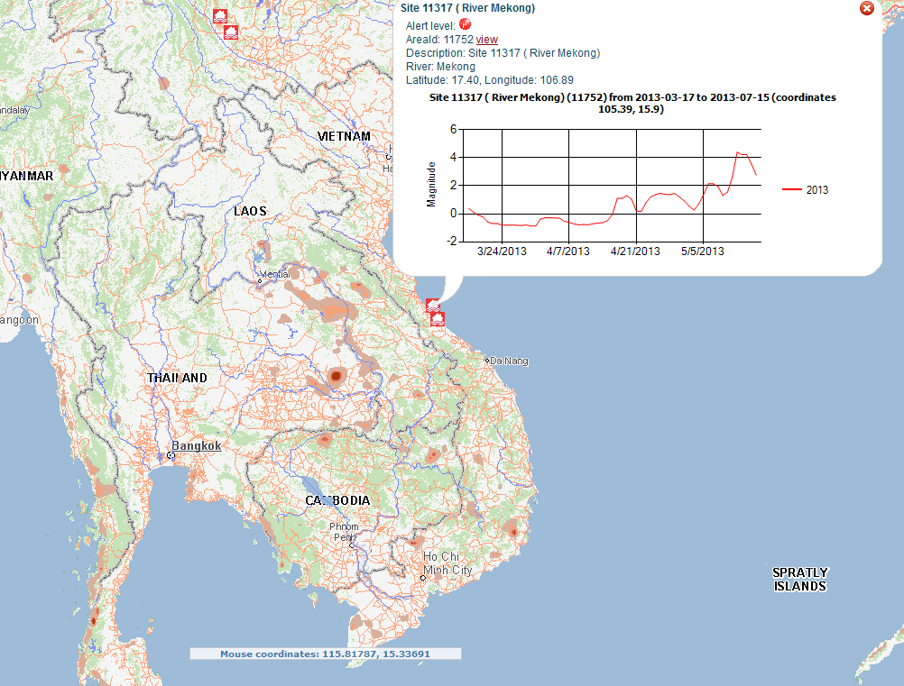
Monitoring: Global Flood Detection System (GFDS)
  Novel products for international aid and Added value for National Services
    Continuous mapping and estimation of flood extent via satellite imagery
    Global application allowing monitoring also of un-gauged rivers
    Assessment of flood impact

Slide 7
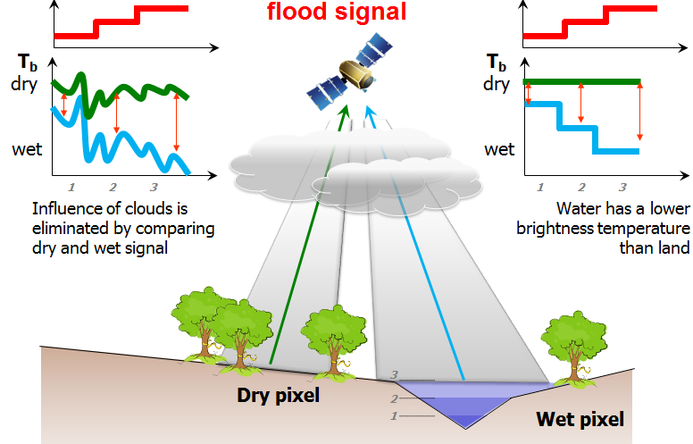
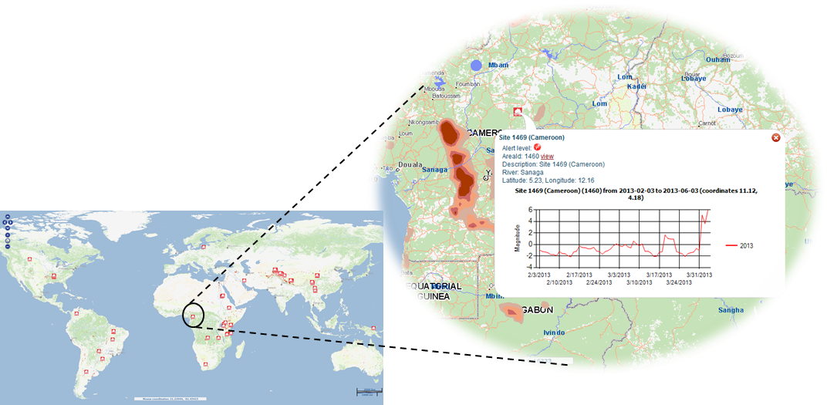
Monitoring: Global Flood Detection System (GFDS)
Water signal from passive microwave sensor
    Flood alert display on a world map
    Not sensitive to cloud cover
http://www.gdacs.org/flooddetection

Slide 8
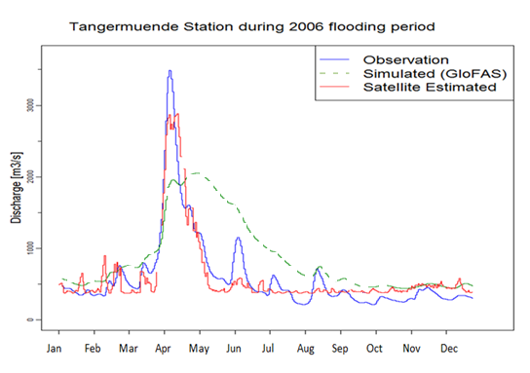
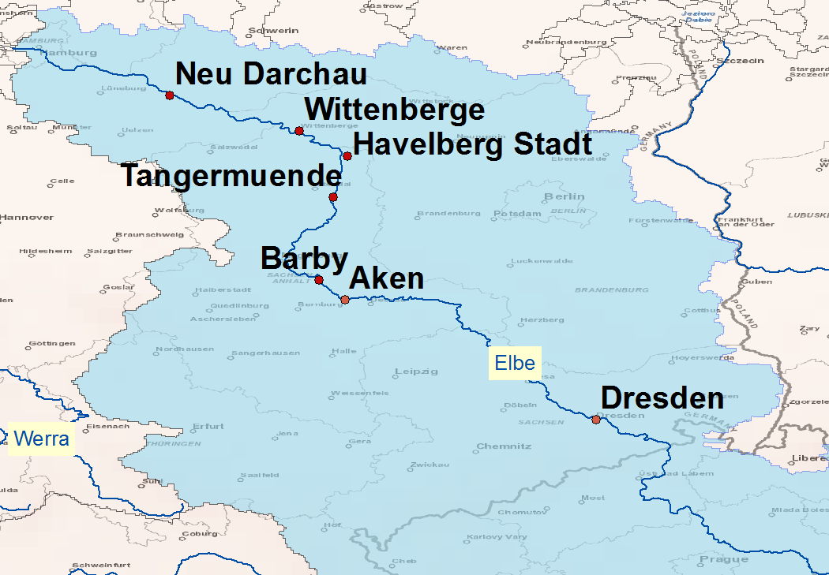
Combining flood forecasting and detection
  Elbe River Floods April-May 2006
  In situ discharge observations
  Simulated discharge Global Flood Awareness System (GloFAS) - UNCALIBRATED
  Estimated discharge Global Flood Detection System (GFDS)
Onset of floods well forecast and detected
Hydrological model requires calibration for flood routing
21 May 2013

Slide 9
Integration of the two systems towards a robust global flood risk management tool
Improving the individual systems
  Use GFDS information for:
    Calibration of GloFAS model
    For post-processing of GloFAS forecasts
  Identify false GFDS signals with GloFAS flood hazard map
  Complement GFDS with GloFAS information to improve performance
Novel integrated products
  Analog method – search archive of detected events based on GloFAS results and map event probability
  Coherent global information (flood forecast & flood detection visualised in a single platform)
21 May 2013

Slide 10
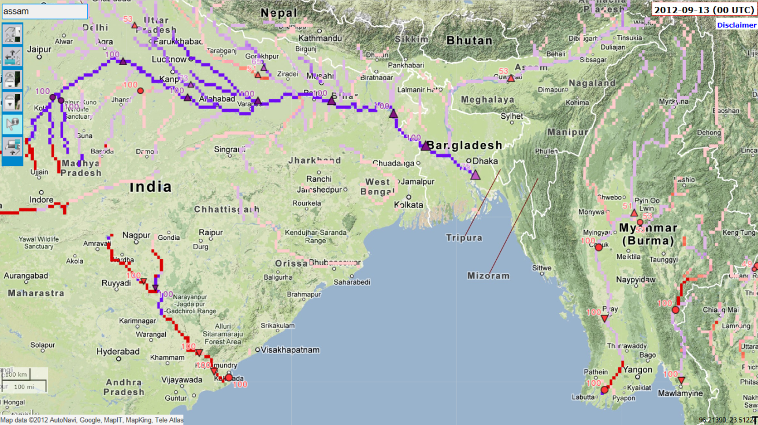
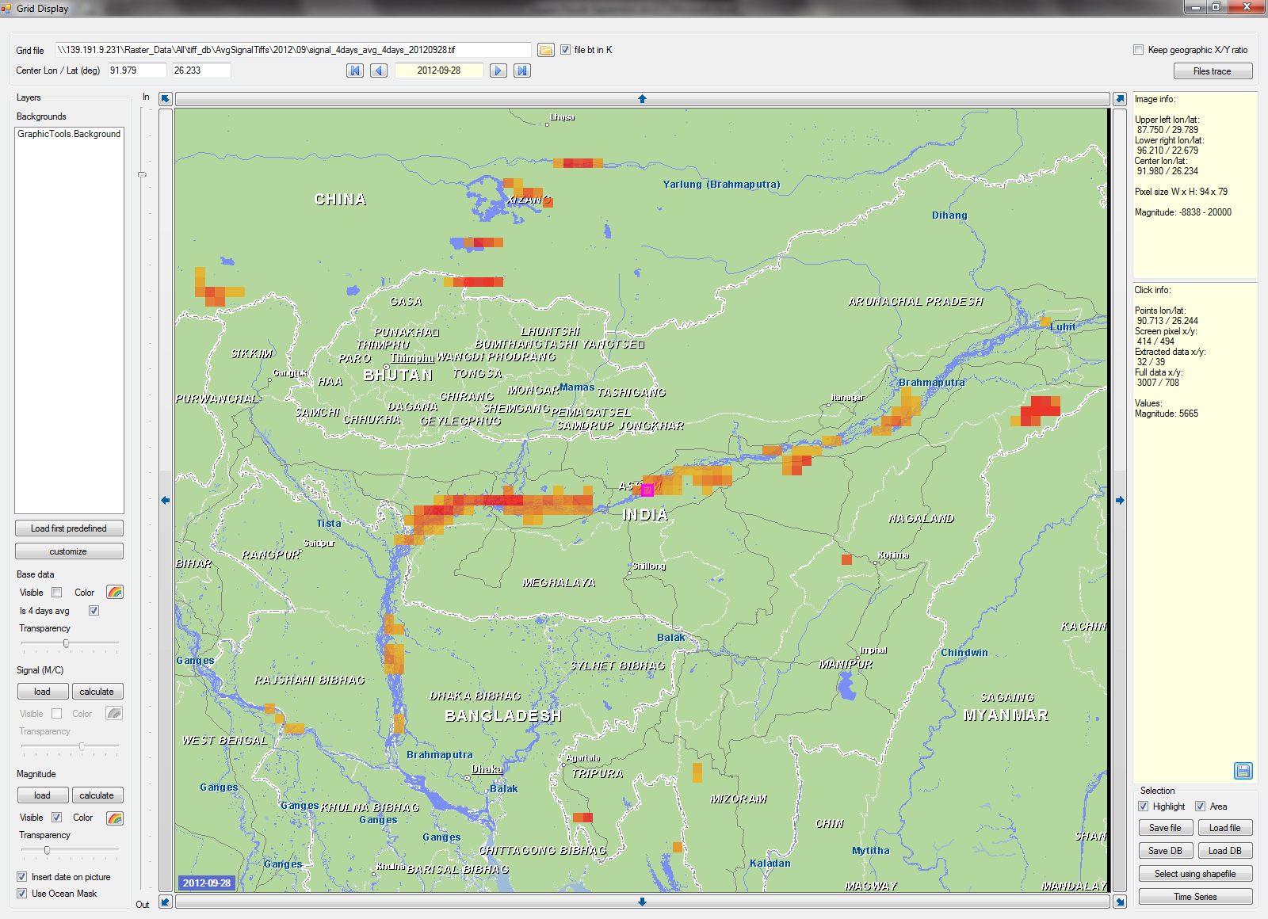
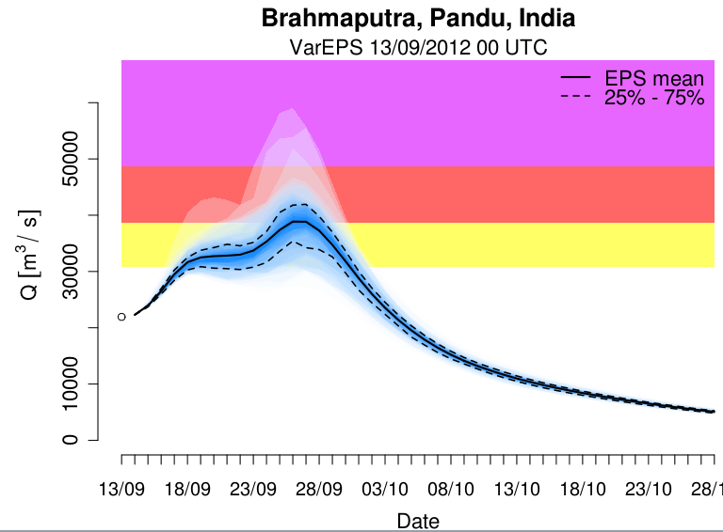
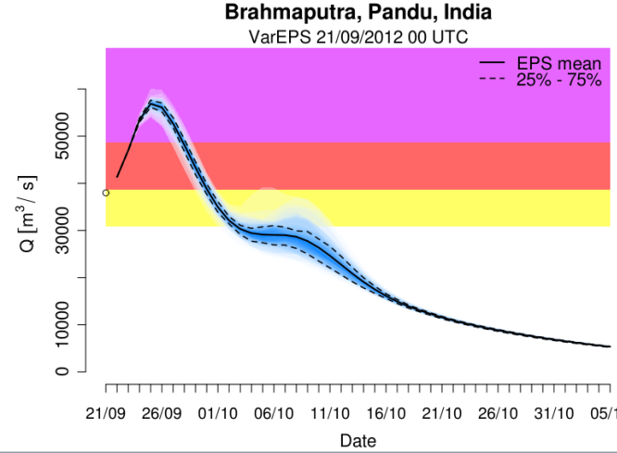
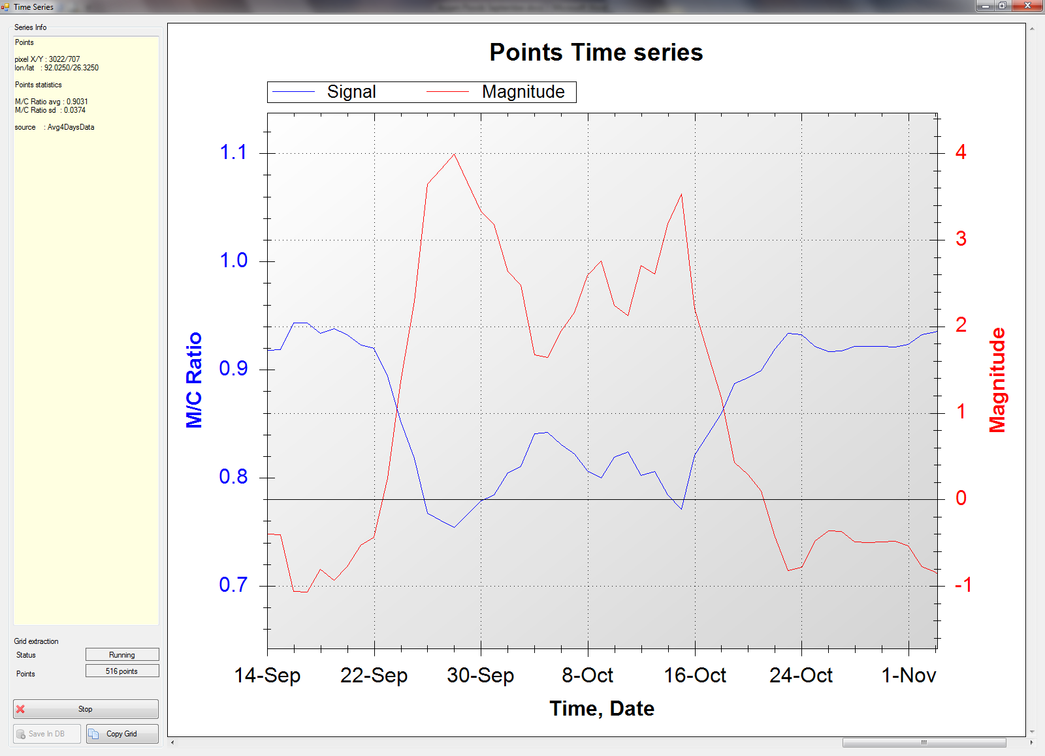
Combining flood forecasting and detection
Reduce uncertainty
Coherent global information
Assam (India) Floods: September – October 2012
Duration in Days | Dead | Displaced
27 | 21 | 2000000
Global Flood Awareness System (GloFAS) Forecasts
Global Flood Detection System (GFDS)

Slide 11
Bridging the gap between science and operations – a multidisciplinary challenge for effective disaster risk reduction and climate risk management
Remote sensing
Hydro logy
GIS and mapping
Humani-tarian respon-ders
Industry
Meteoro logy
Development organizations
Modeling

Slide 12
Conclusions
Unique solution for integrated global flood detection and flood forecasting in support to International aid organisations and National Authorities is being developed
        Integration Remote Sensing and state of the art Hydro-meteorological ensemble forecasting techniques
        First prototype of Global Flood Detection and Forecasting systems show encouraging results
Development of global systems require collaborations and input from science, operational services and policy makers

Slide 13
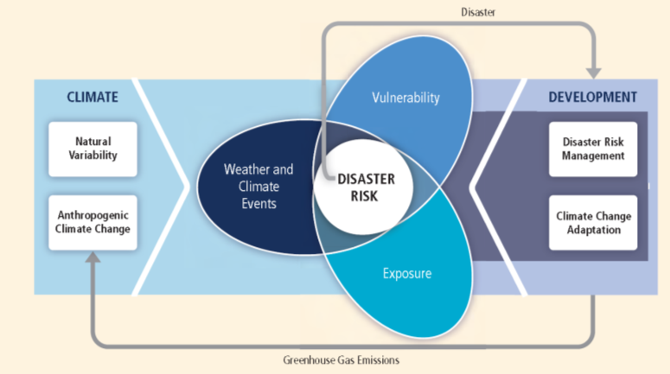
For more information, read our papers or contact us
Alfieri, L., Burek, P., Dutra, E., Krzeminski, B., Muraro, D., Thielen, J., and Pappenberger, F.: GloFAS – global ensemble streamflow forecasting and flood early warning, Hydrol. Earth Syst. Sci., 17, 1161-1175, doi:10.5194/hess-17-1161-2013, 2013.
Kugler, Z, De Groeve, T. The Global Flood Detection System. European Commission (EC); European Commission Joint Research Centre (JRC); Institute for the Protection and Security of the Citizen (IPSC)2007.
beatriz.revilla-romero@jrc.ec.europa.eu
www.efas.eu
www.gdacs.org/flooddetection
IPCC-SREX (2011)

